Slide 1

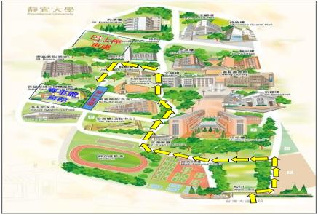
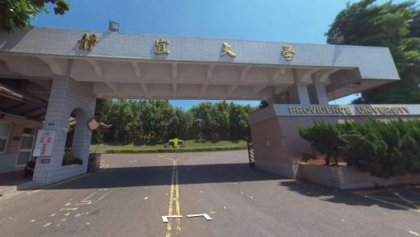
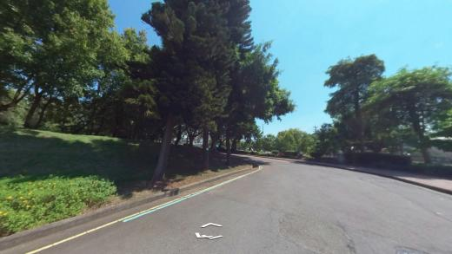
Providence University
Bus and Car → Gymnasium Entrance Route
Show Current Location
Show Current Location
Street View Map
Google Maps

Slide 2
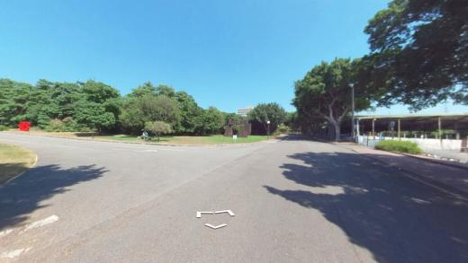
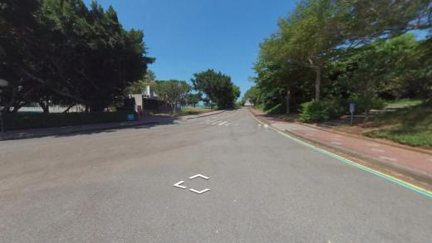
Providence University
Bus and Car → Gymnasium Entrance Route
Show Current Location
Show Current Location
Street View Map
Google Maps

Slide 3
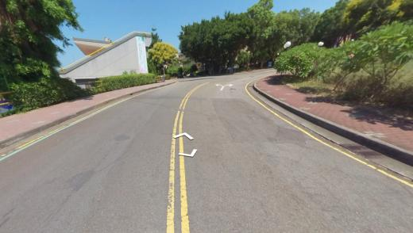
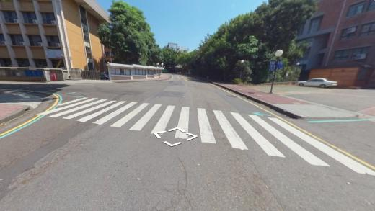
Providence University
Bus and Car → Gymnasium Entrance Route
Show Current Location
Show Current Location
Street View Map
Google Maps

Slide 4
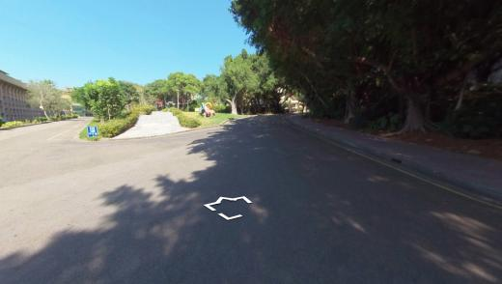
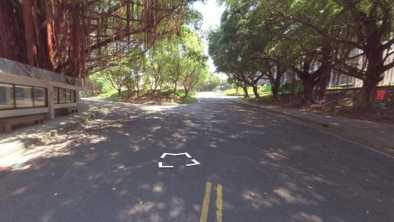
Providence University
Bus and Car → Gymnasium Entrance Route
Show Current Location
Show Current Location
Street View Map
Google Maps

Slide 5
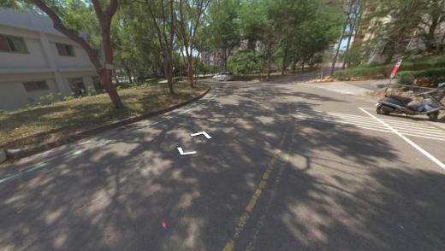
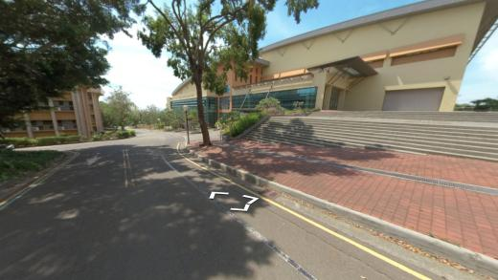
Providence University
Bus and Car → Gymnasium Entrance Route
Show Current Location
Show Current Location
Street View Map
Google Maps

Slide 6
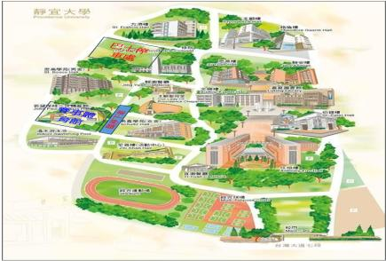
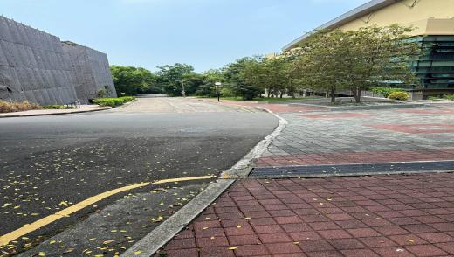
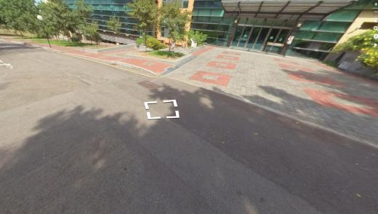
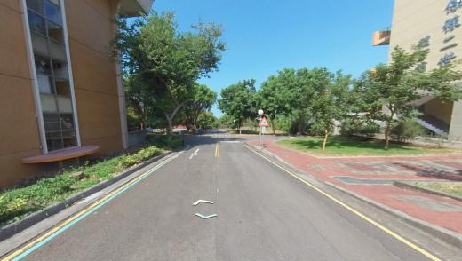
Gymnasium Temporary Bus Drop-off Areas
(Total of 3 Locations)
P1
P2
P1
P3
P2
P3
Street View Map
Street View Map
Google Maps

Slide 7
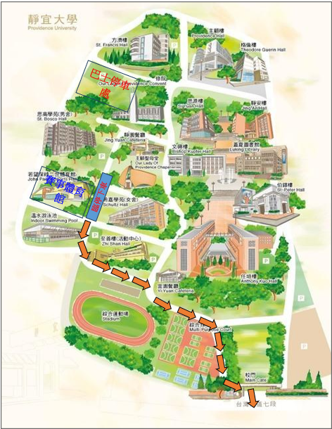
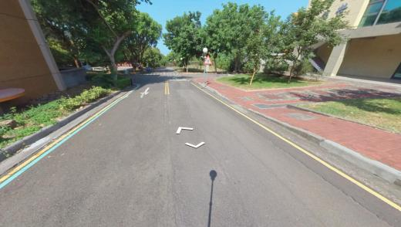
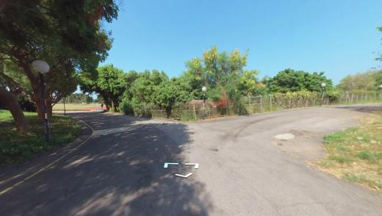
Providence University
Bus Route to the Main Gate
Show Current Location
Show Current Location
Street View Map
Google Maps

Slide 8
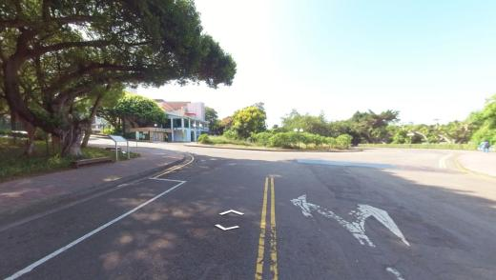
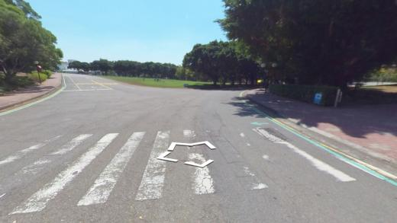
Providence University
Bus Route to the Main Gate
Show Current Location
Show Current Location
Street View Map
Google Maps

Slide 9
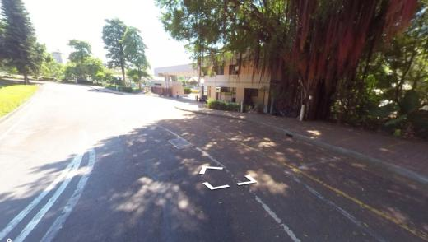
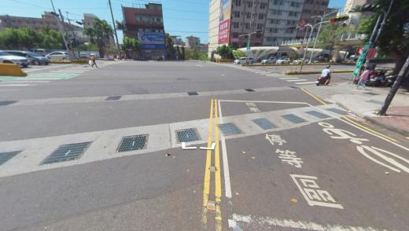
Providence University
Bus Route to the Main Gate
Show Current Location
Show Current Location
Street View Map
Google Maps

Slide 10
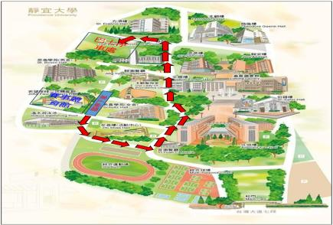
Providence University
Bus Route to the Parking Area
Show Current Location
Show Current Location
Street View Map
Google Maps

Slide 11
Bus Route to the Parking Area at
Providence University
Providence University
Bus Route to the Parking Area
Show Current Location
Show Current Location
Street View Map
Google Maps

Slide 12
Bus Route to the Parking Area at
Providence University
Providence University
Bus Route to the Parking Area
Show Current Location
Show Current Location
Street View Map
Google Maps

Slide 13
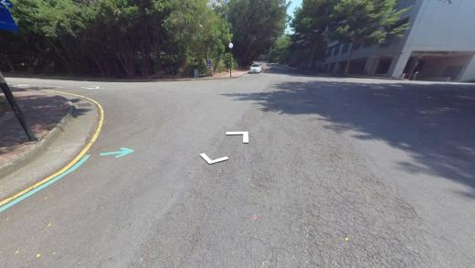
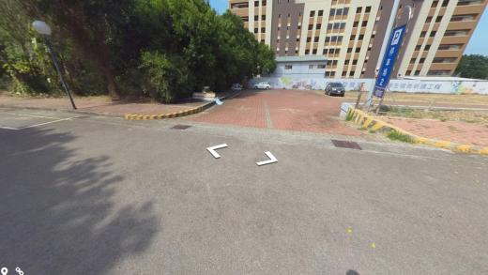
Bus Route to the Parking Area at
Providence University
Providence University
Bus Route to the Parking Area
Show Current Location
Show Current Location
Street View Map
Google Maps

Slide 14
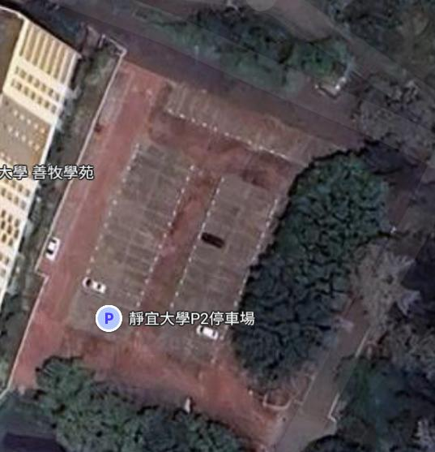
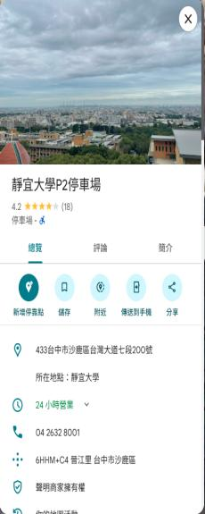
Providence University
Parking Lot 2 can accommodate around 12 buses
Enter the parking lot
Exit the parking lot
Street View Map
Google Maps

Slide 15
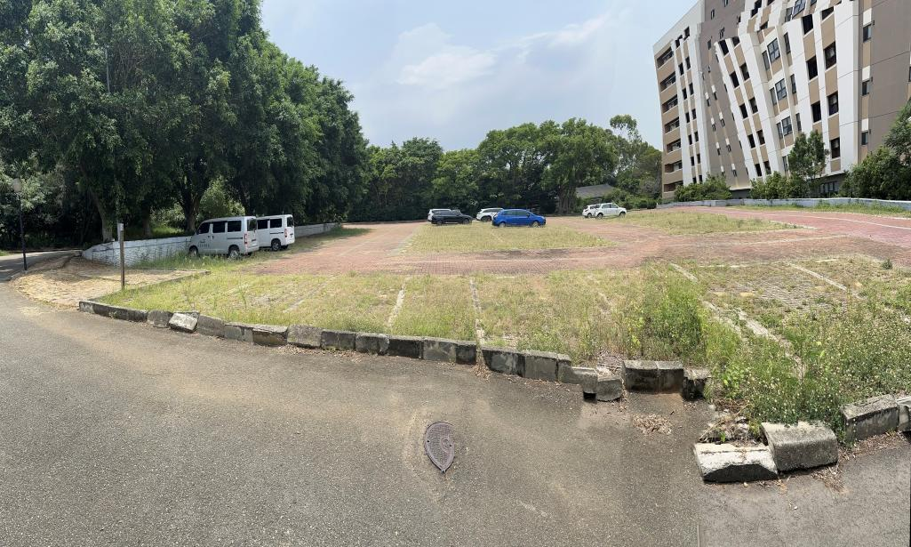
Providence University
Parking Lot 2 can accommodate around 12 buses
Enter the parking lot
Exit the parking lot
Street View Map
Google Maps

Slide 16
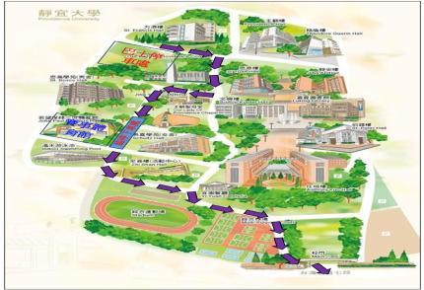
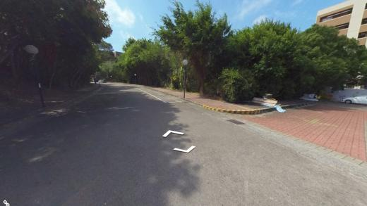
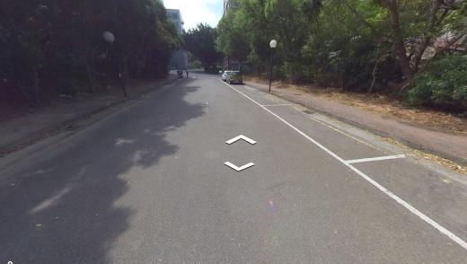
Route within Providence University :
Bus Parking Lot → Gymnasium → Main Gate
Show Current Location
Show Current Location
Street View Map
Google Maps

Slide 17
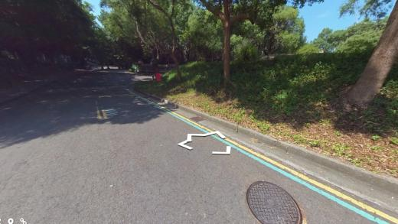
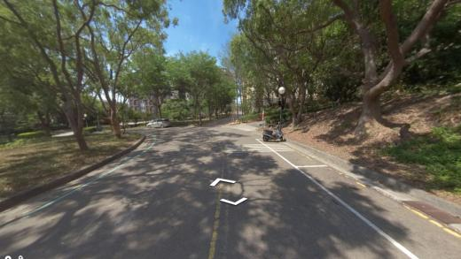
Route within Providence University :
Bus Parking Lot → Gymnasium → Main Gate
Show Current Location
Show Current Location
Street View Map
Google Maps

Slide 18
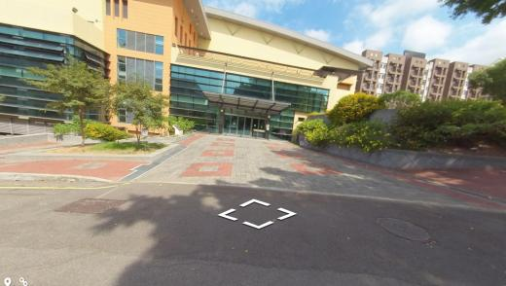
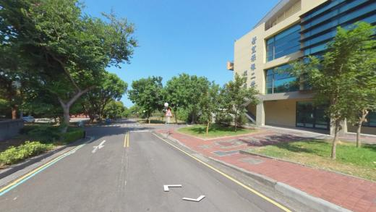
Route within Providence University: Bus → Gymnasium → Main Gate
Route within Providence University :
Bus Parking Lot → Gymnasium → Main Gate
Show Current Location
Show Current Location
Street View Map
Google Maps

Slide 19
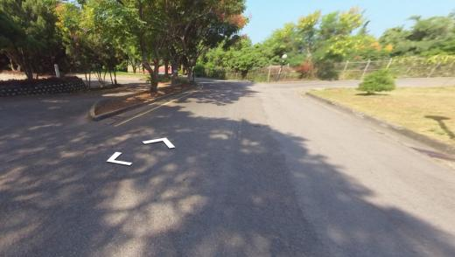
Route within Providence University :
Bus Parking Lot → Gymnasium → Main Gate
Show Current Location
Show Current Location
Street View Map
Google Maps

Slide 20
Route within Providence University :
Bus Parking Lot → Gymnasium → Main Gate
Show Current Location
Show Current Location
Return Home
Street View Map
Google Maps

